Slide 1
Subject : Distributed Systems
Topic
(RADIUS)
Remote Authentication Dial-in User Service

Slide 2
Subtopics
What is RADIUS?
Primary Functions provided by RADIUS protocol
AAA Security Framework & its application : RADIUS
A Real World Analogy
Basic architecture for NAS/RADIUS/AAA
Working of RADIUS
Advantages & Disadvantages

Slide 3
What is RADIUS?
RADIUS, which stands for "Remote Authentication Dial In User Service” .
It is a networking protocol, operating on ports 1812 and 1813, that provides centralized Authentication, Authorization, and Accounting management for users who connect and use a network service.
is a network protocol which controls user network access via authentication and authorization. Commonly used by Internet Service Providers (ISPs), cellular network providers, and corporate and educational networks.

Slide 4
The RADIUS protocol serves three primary functions:
Authenticates users or devices before allowing them access to a network
Authorizes those users or devices for specific network services
Accounts for the usage of those services
The RADIUS protocol is generally hidden inside of controlled networks, and is not seen directly by end users. i.e. it is run between trusted systems in the network.

Slide 5
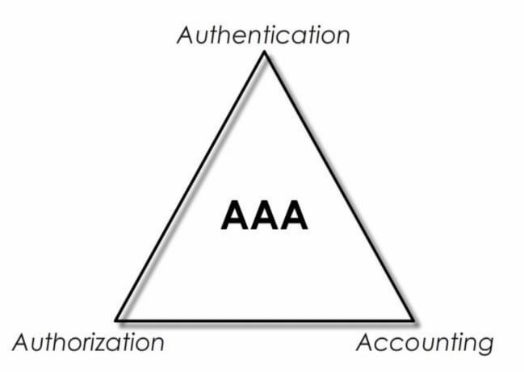
AAA Security Framework & its application : RADIUS
AAA Stands for Authentication, Authorization, Accounting .
It is a fundamental security framework for controlling a user’s access to a network, determining access levels or user privileges based on policies and user identity, and keeping track of user’s activities.
Who are you ?
(You need some credentials normally, username & password to verify your identity)
It keeps track of your log activities
Which may include what resources you used
How much you used
How long you used, and etc.
Data collected at this stage could be used for controlling, monitoring, billing, statistics and so on.
What can you do ?
- It is about what you can do.
The priviledges can include what kinds of resources or services you can access,
What tasks you can perform ?
And how long you can use these resources.

Slide 6
A Real World Analogy
The following analogy illustrates the difference between Authentication and Authorization.
- Imagine you are driving a car and you are stopped by a police officer. The officer asks you to provide a piece of identification to identify yourself. You could, for example, use your passport, driver’s license, or ID card to prove (i.e. authenticate) who you are. In terms of the RADIUS protocol, the authentication process identifies the user as someone who is known to the system. However, the fact that a user is known does not automatically mean that the user has authorization to do anything at all.
- In the example above, the police officer may also ask you to prove that you are authorized to drive. In this case, there is only one document - a driver’s license, which proves that you are permitted (i.e. authorized) to drive a car.
- The authorization process thus combines the policy on the RADIUS server and the information in the request from the NAS. The NAS may add additional information to the request, such as the user’s Media Access Control (MAC) address. The NAS sends the information to the server, where an authorization decision is made.
- Once the server processes this information, it sends a response to the NAS with instructions detailing which actions are allowed or denied. The NAS then monitors the user’s
Important :During the user’s network session the policies are essentially static. In some cases, the server may change policies, and inform the NAS. There is no way for the user to request policy changes in RADIUS. The user must instead disconnect, and reconnect.

Slide 7
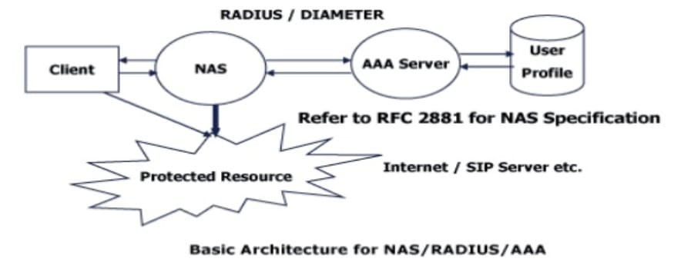

Slide 8
Working of RADIUS?
- When other device wants to access Network Access Server, it will send access request message to ACS(Access Control Server) for matching the credentials.
- In response to the access request to the client, the ACS server will provide an access-accept message to the client if the credentials are valid.
And access reject if the credentials do not match.

Slide 9
Advantage –
As it is open standard, therefore it can be used between the other devices also.
Greater extensive accounting support than TACACS+
Disadvantage –
As RADIUS uses UDP therefore it is less reliable than TACACS+.
RADIUS encrypt only the passwords. It doesn’t protect other data such as username.

Slide 10
THANK YOU

